Slide 1
Sonobuoy Software
FigureExamples

Slide 2
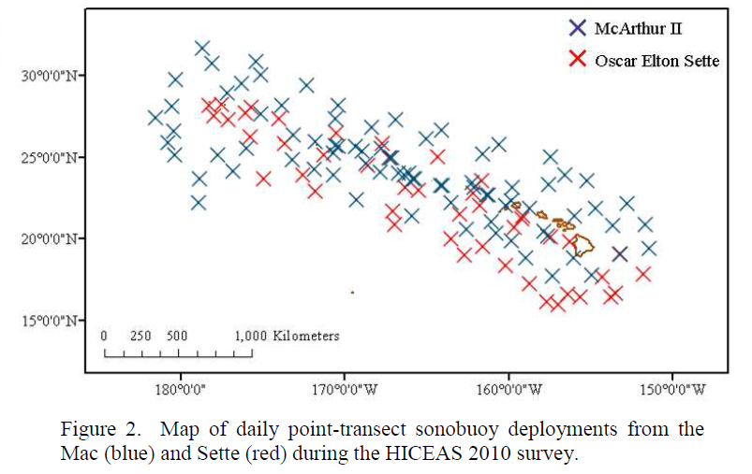
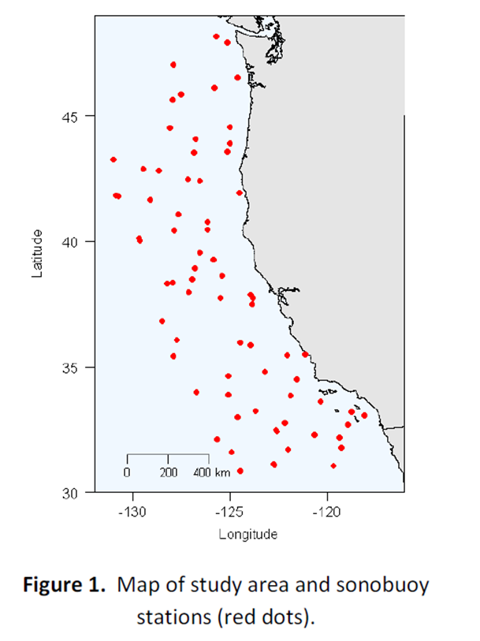
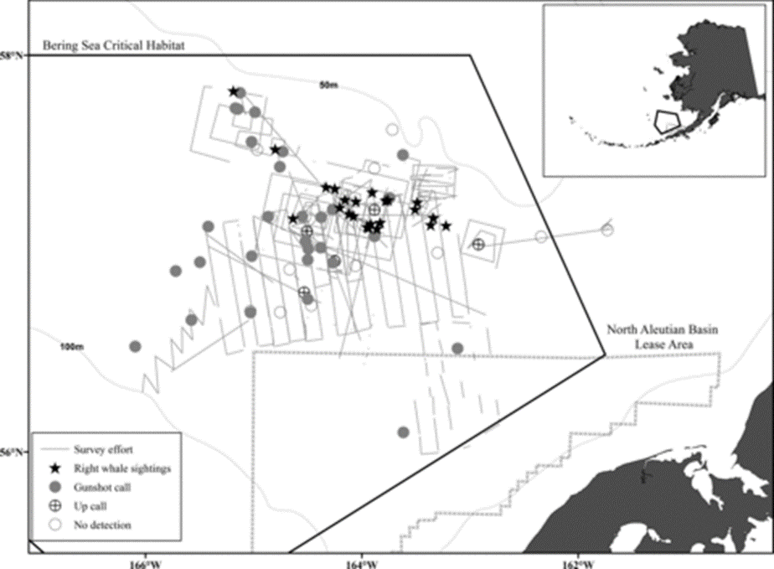
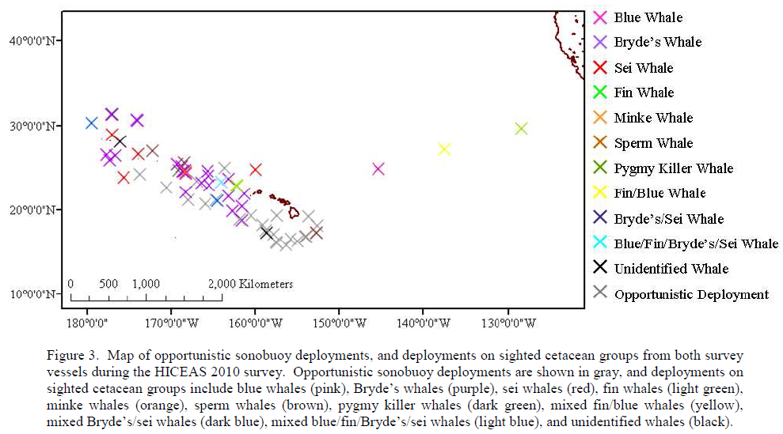
Maps: Cruise Report
Summary Map
may include trackline effort imported from Whaltrak (or other csv file?)
Include options for bathymetry, coastlines (ERRDAPP SST or other values?)
Select buoy type (station vs. opportunistic) [NOTE: SR needs to decide where this info will be going forward!]
Opportunistic: Symbols by species
May overlap Opportunistic & Stations– using a specific symbol for stations

Slide 3
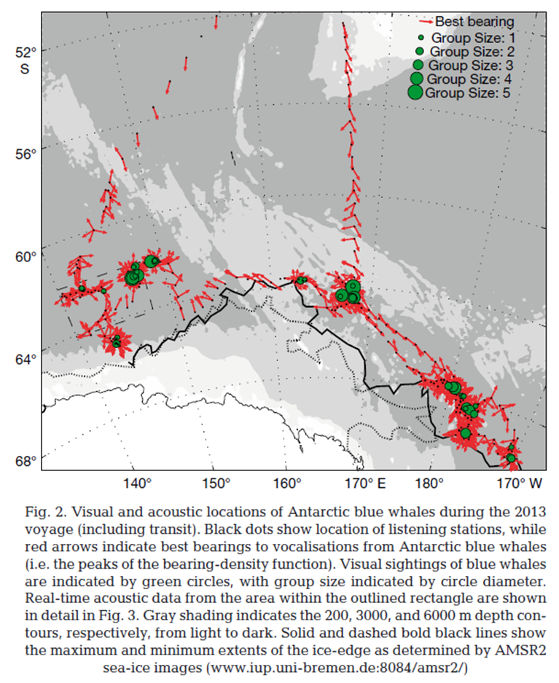
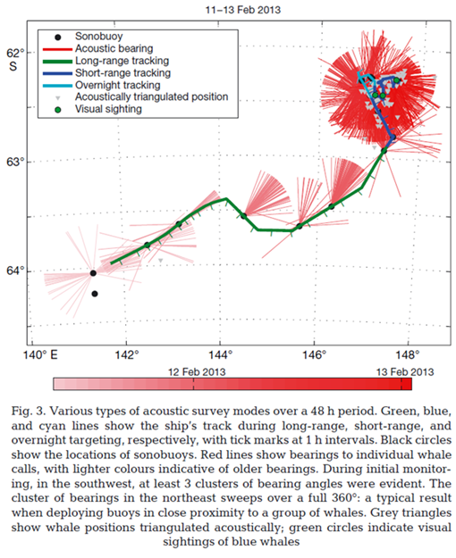
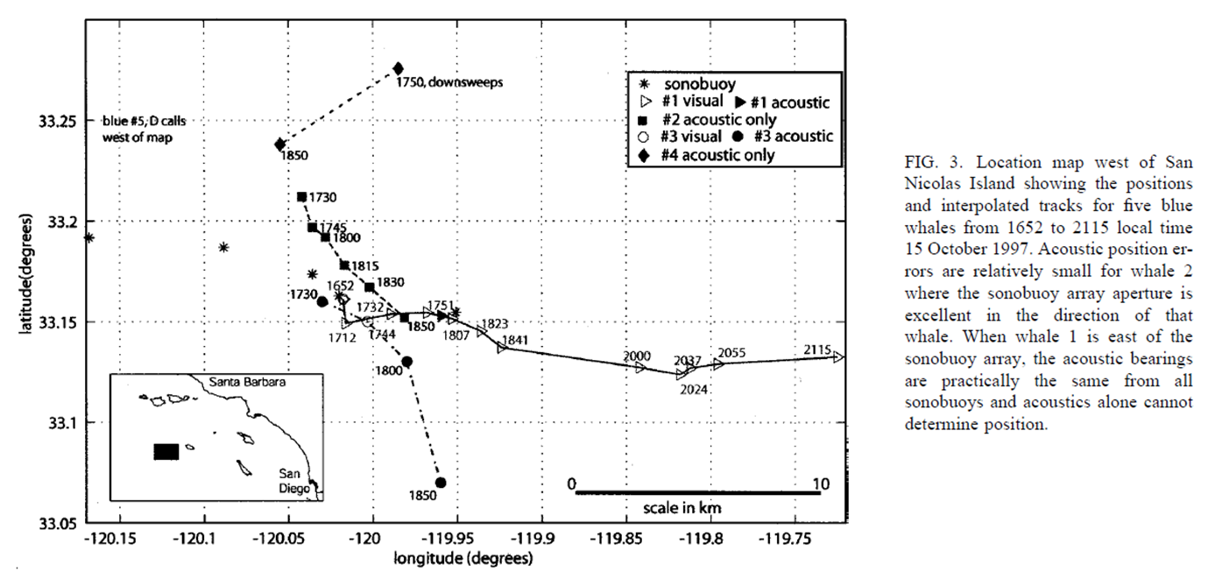
Maps: Research
Tracking Map
may include trackline effort imported from Whaltrak (or other csv file?)
May include option to show time progression along ship track or whale track
Show times along track? Or color track as time goes by?
May include sighting/resight locations (from Whaltrak or other csv file?)
Include options for bathymetry, coastlines (ERRDAPP SST or other values?)
Buoy Symbol: Options to size symbol by # detections on that buoy or call type?
Show bearing angles and/or locations (depending on # of buoys or zoom)
Options to show for all buoys or subset (zoom)

Slide 4
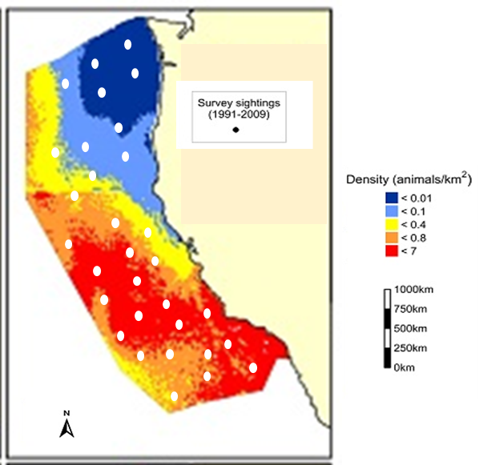
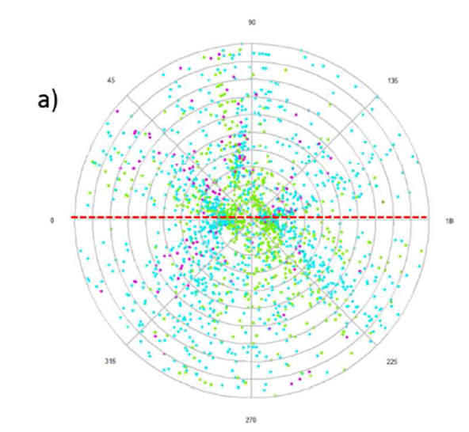
Maps: Density Estimation
Survey Map
Like Cruise report map, but with more details related to Density Estimation
Options to show for all buoys or subset (zoom)
Include options for bathymetry, coastlines (ERRDAPP SST or other values?)
Buoy symbol size/type options
By # calls of a given call type, proportion of calls of different call types (pie chart?)
[overlay w/ colored animal density plot using visual data?- talk w/ Elizabeth Becker, Jay/Jeff]
May include trackline effort imported from Whaltrak (or other csv file?)
Polar Plot (overlay all stations)
Overlay All/Subset sonobuoy stations (w/ optional # of sonobuoys/station)
Orient according to sonobuoy axis (shown) or compass bearing
Detection Symbol: symbol based on call type or ?
Single Station Maps (like the one Taiki was just working on)
Plot of sonobuoys w/ localized call(s) with localization error/probabilities
Allow for single calls or overlay of all/subset of calls for a station
Can this be extended to overlay multiple stations & localizations to visualize how error might be related to location of the call in the sonobuoy space?
‘Animate’ by first normalizing all buoys (same orientation of sonobuoy axis), then showing all localizations for that buoy for a few seconds, then advancing to the next station???

Slide 5
Cruise Report: Tables
[Note: I need to examine new Pamguard update and decide how to move forward w/ metadata, then I can determine who/what/where for tables]
Buoy-based Summary Table: DEFAULT
Date/Time
Lat/Long
Station ID
# buoys
Recording & Effort Duration (total recording time, total time monitored)
Species-based Summary Table: DEFAULT
Species
Call Types
Recording & Effort Duration (total recording time, total time monitored)
# Sonobuoys w/ detections
# detections (total)

